Slide 1


Presenting
Erasmus without Paper 2.0
João Bacelar

Slide 2
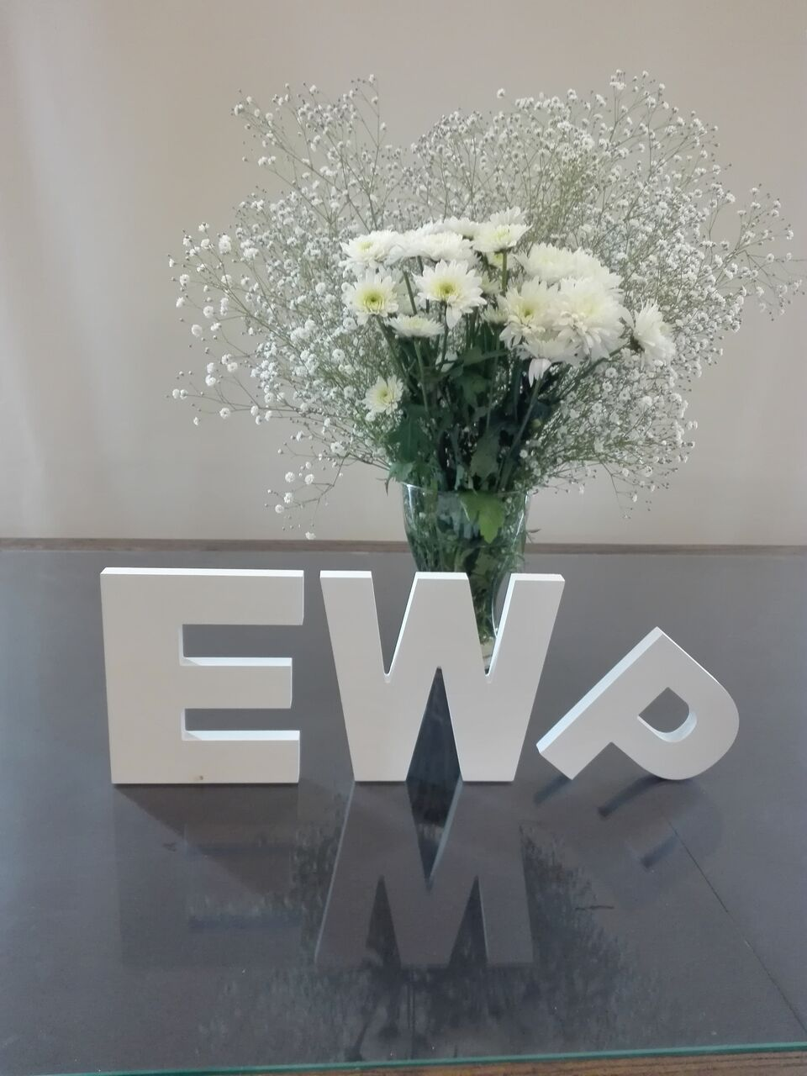
What does EWP stand for?

Slide 3


flexible
scalable
secure

Slide 4
75%?
more efficient

Slide 5
HOW

Slide 6
Act I: commercial software providers
Act II: in-house SIS
Act III: culture change

Slide 7
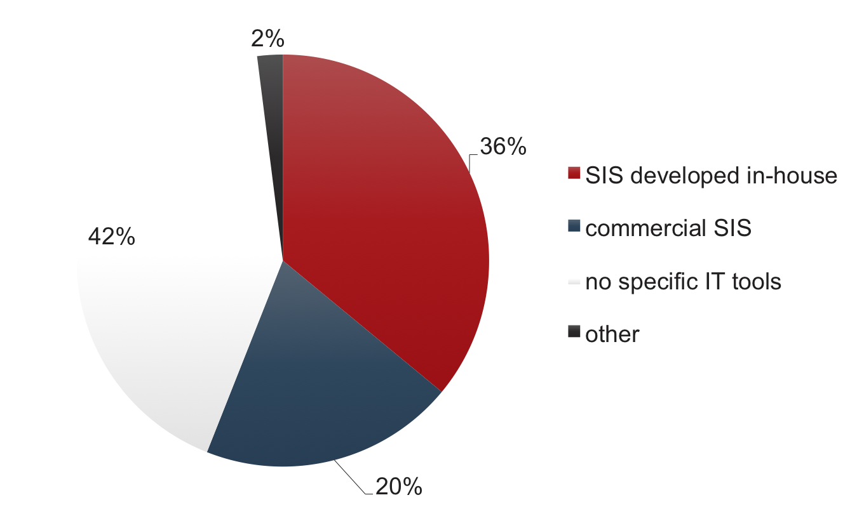
Act I: commercial providers
Act II: in-house SIS
Act III: culture change
Mapping of IT infrastructure among ECHE holders

Slide 8



Slide 9
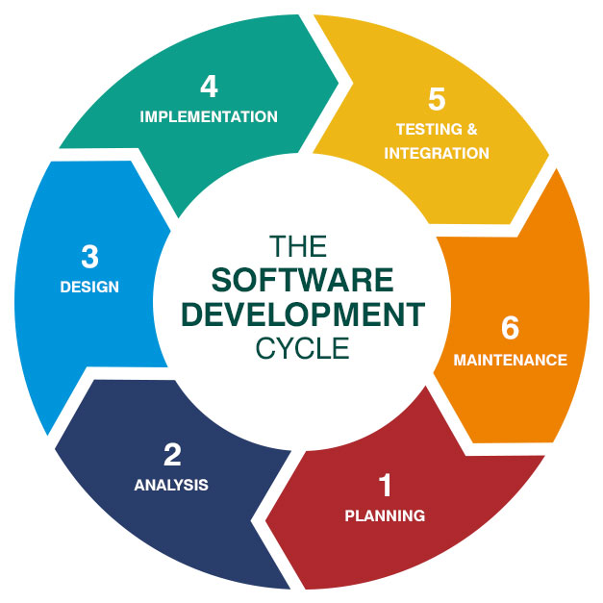
Test prototype
Further development
Further testing
Industrialization

Slide 10

EWP network release date
December 2018

Slide 11


Time for HEIs to prepare and join

Slide 12

Adoption costs?
Adoption speed?
Decision-making x1800?

Slide 13

Open source code repository
support developers ➔ lower costs ➔ better quality and security

Slide 14
Repository release date: Dec 2018
Launch of the Alliance: today!

Slide 15
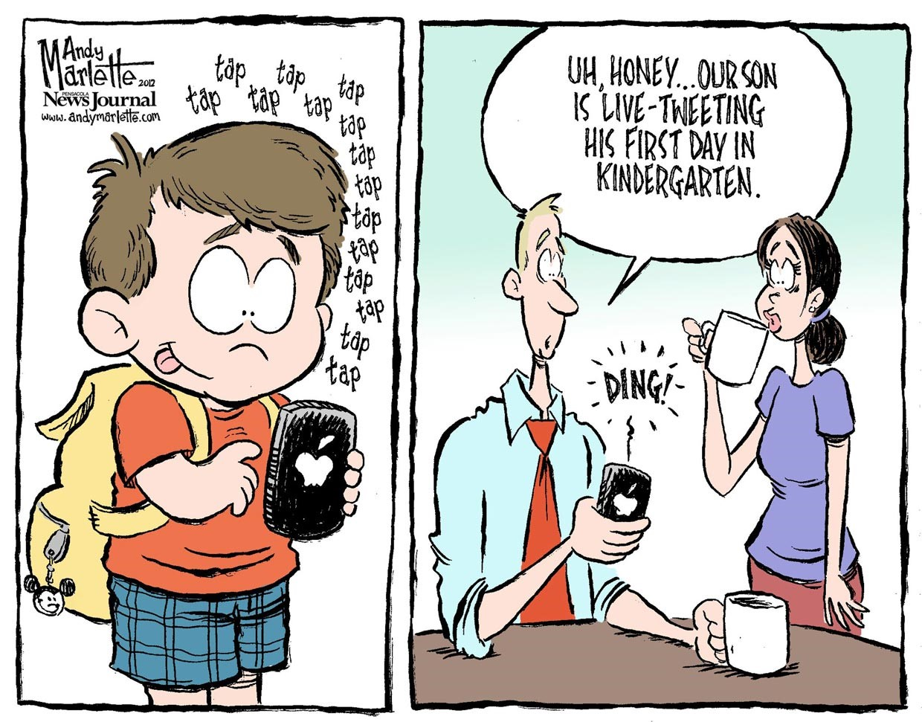
Yet
another
challenge…

Slide 16
Digital change is cultural change!!
developing technology is easy
making the most out of it… not always!

Slide 17
Technical documentation
Training toolkit
Practical examples
EWP Competence Centre

Slide 18
OS code repository
EWP Competence Centre
new EWP 2.0
deliverables

Slide 19
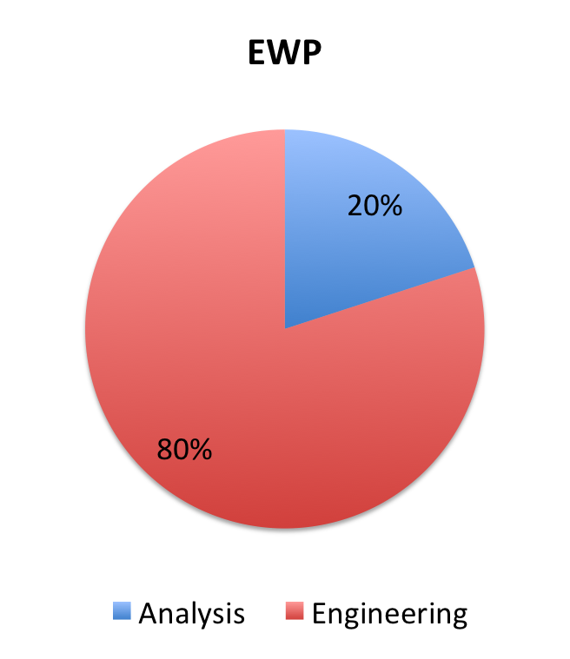
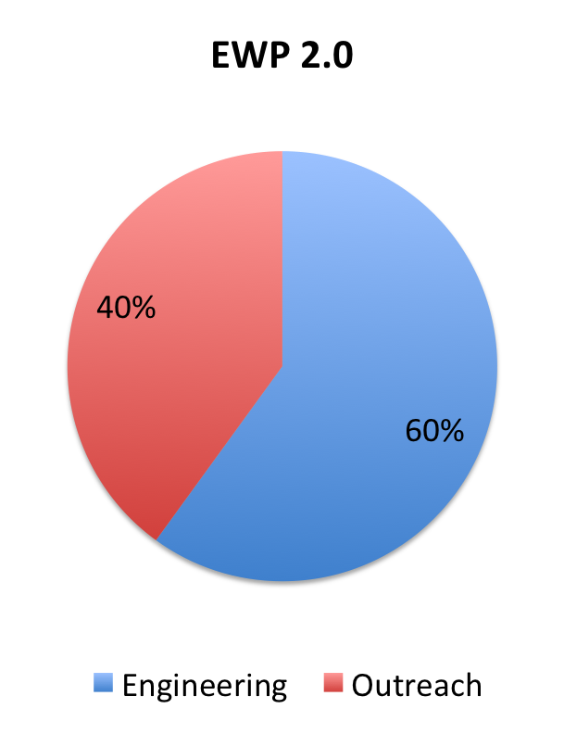

Slide 20


No university left behind!

