Slide 1

EMREX and EWP compared
Erasmus Without Paper – offering digital services in the higher education area
Janina Mincer-Daszkiewicz, University of Warsaw, Poland

Slide 2


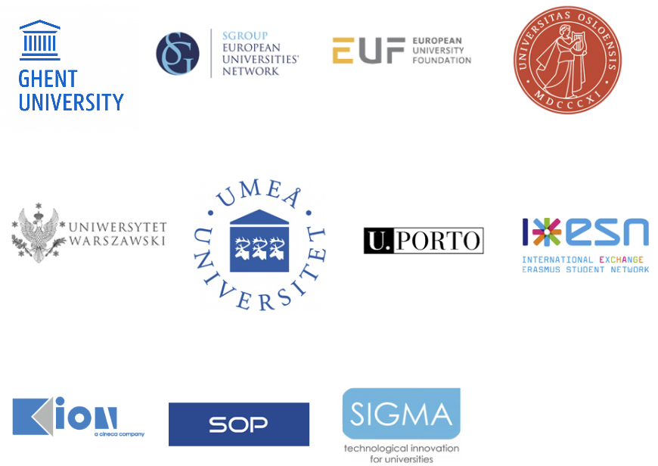
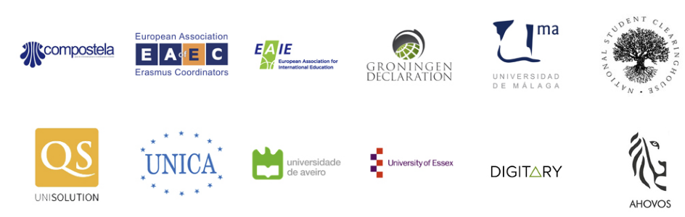
The EWP project
ERASMUS+
Erasmus Without Paper
Partly funded by Erasmus+
Visit us at erasmuswithoutpaper.eu

Slide 3
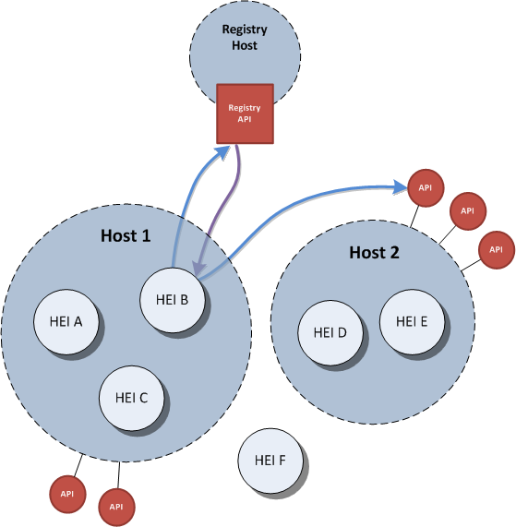
The solution
Requirements gathered via a large
questionnaire – 1050 replies from 31 countries
developers.erasmuswithoutpaper.eu
github.com/erasmus-without-paper

Slide 4
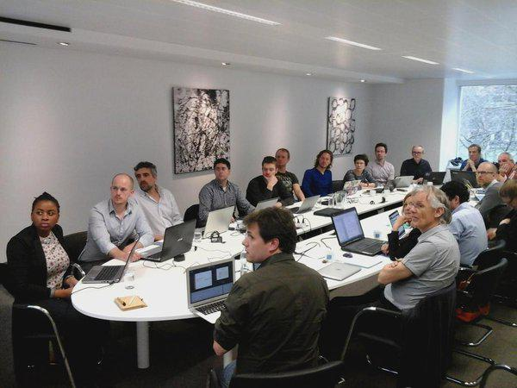
State of work
Use cases and recommendations for developers
Design of architecture, security, data flow
API specifications
Data model
Data formats (data types for API parameters)
Registry up and running
APIs being succesfully implemented by the partners
Testbed up and running

Slide 5

link to demo USOSadm
link to demo USOSweb
Illustration: Colourbox.no

Slide 6
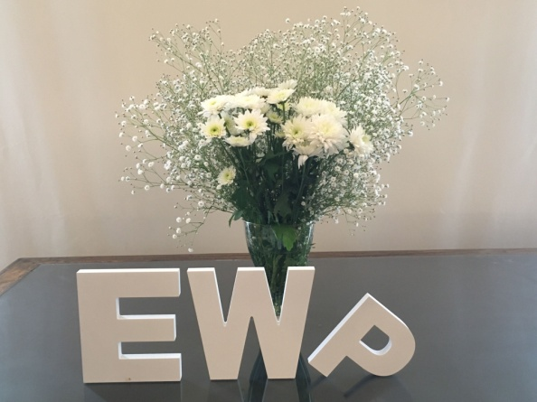
EWP 2.0 (2018-2019?)
14 full partners and 13 associate partners.
Turning the proof of concept into a product to be launched at the end of 2018.
Tuning and improving functionality (e.g. grade conversion, integrating APIs with local processes).
Development of the Competence Centre.
Creation of the EWP Hub.
Integration with other projects (OLA, ESC, EMREX).

Slide 7

EMREX and EWP compared – 1
Stakeholders, beneficiaries, ownership of the business process, responsibility
Data range, data model, data format, data availability, source of data
Authorization, privacy, security, digital signatures, data exchange protocols
Integration with local processes (with necessary changes, depending on the cultural context)

Slide 8
EMREX and EWP compared – 2
Dissemination, scalability, sustainability, steadily growing set of services (open vs. closed)
Central registry, open source published in GitHub (specifications, code)
Desirable convergence process →
  Common platform with one registry, complementary set of digital services offered by HEIs, users decide which services to use (deliver), common set of rules (e.g. for accepting new partners)

Slide 9
Q&A
Acknowledgments
EWP and EMREX projects are co-funded by the Erasmus+ Programmes of the European Union.
In Poland they are also co-financed by the Polish Ministry of Science and Higher Education from the funds allocated in the years 2016-2017 for science, granted to international co-financed project.

